Slide 1



Hackathon
AI TRAFFIC LIGHT OPTIMIZER
Team Members
Shivam Paliwal – Team Leader & Integration
Aryan Bhandari – Signal Logic
Aditya Tiwari – Model Training & Dataset
Mohd. Arham – Frontend Development
Shivam Kumar Sharma – Vehicle Counting
Gaurav Rawat – Signal Hardware & Circuit Design
Smart Signal Control Based on Real-Time Vehicle Count
Tech Stack: OpenCV + Python

Slide 2
INTRODUCTION
Traffic congestion is a growing challenge in cities. Traditional fixed‑timer signals waste time and fuel, as empty roads face red lights while crowded lanes remain blocked.
Our project AI Traffic Light Optimizer uses real‑time vehicle detection and AI‑based optimization to dynamically adjust signal timings. This ensures smoother traffic flow, reduced waiting time, and a step forward toward smart city infrastructure.

Slide 3
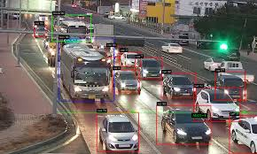
PROJECT GOALS
Specific: Detect & count vehicles per lane
Relevant: Helps traffic flow & emergency response
Measurable: Reduce waiting time ≥20%
Achievable: YOLOv8 + optimization formula
Time-bound: Demo-ready prototype in hackathon

Slide 4

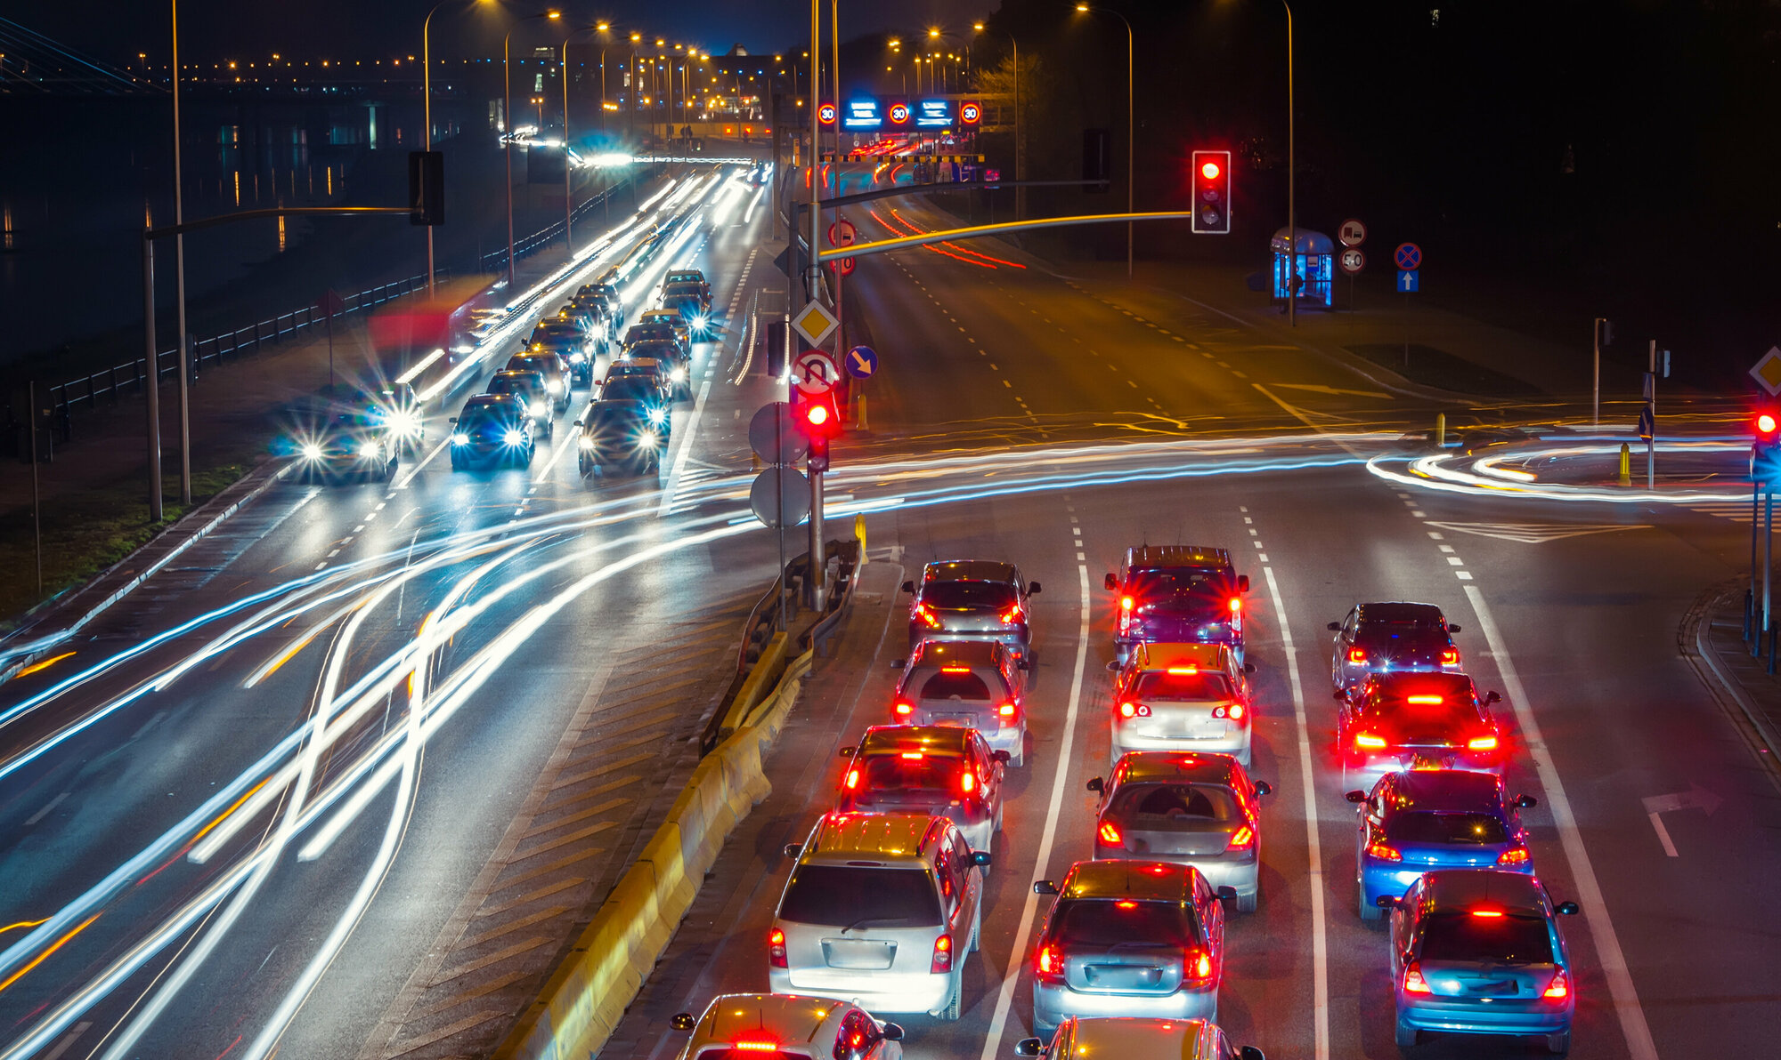
PROBLEM STATEMENT
Traditional traffic lights run on fixed timers
Leads to unnecessary waiting and congestion
Wasted time and fuel

Slide 5
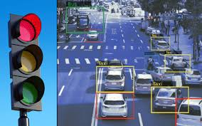
SOLUTION
Use AI to detect vehicles from traffic camera feed
Count vehicles per lane (North, South, East, West)
Adjust green light duration based on congestion
Simulate traffic lights in Python (console/GUI)
Result: Less waiting, smoother flow

Slide 6
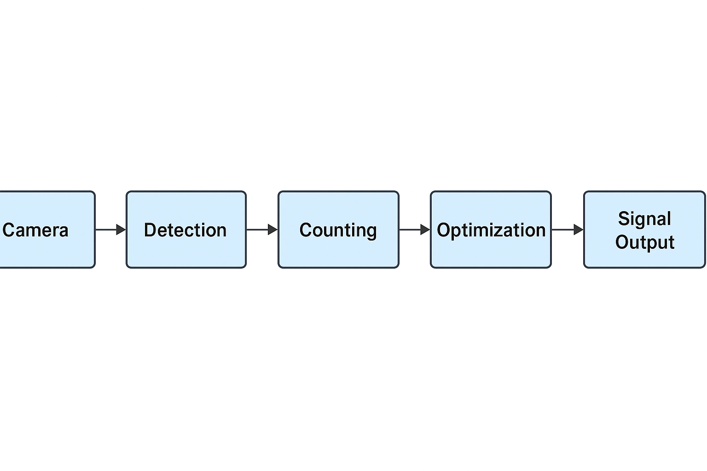
WORKFLOW (PIPELINE)
Video Feed → Vehicle Detection → Count Vehicles → Decide Signal Time → Simulate Lights

Slide 7
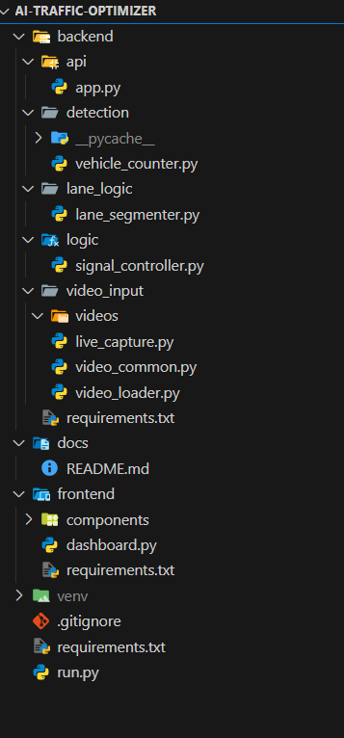
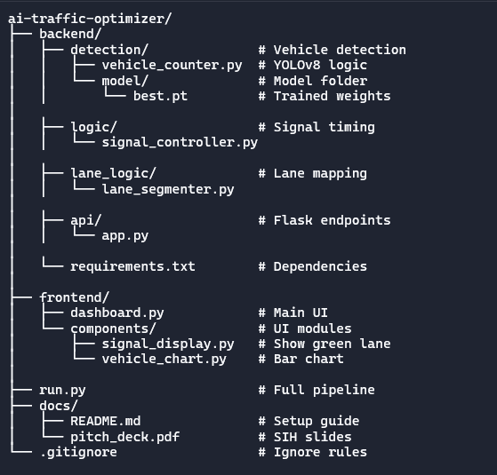
Project Structure — AI Traffic Optimizer

Slide 8
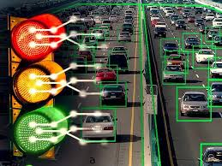
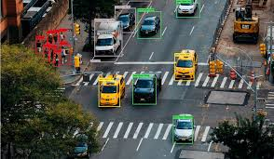
VEHICLE DETECTION
Input: Video or Webcam
Detect vehicles using pre-trained models
Maintain lane-wise counters
Process each frame with OpenCV

Slide 9

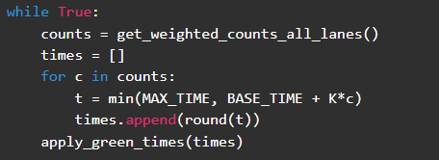
DECISION LOGIC
Formula:
Pseudocode for controller:
Example:
Lane A → 12 cars → Green 34 sec
Lane B → 6 cars → Green 22 sec
More vehicles = longer green signal

Slide 10
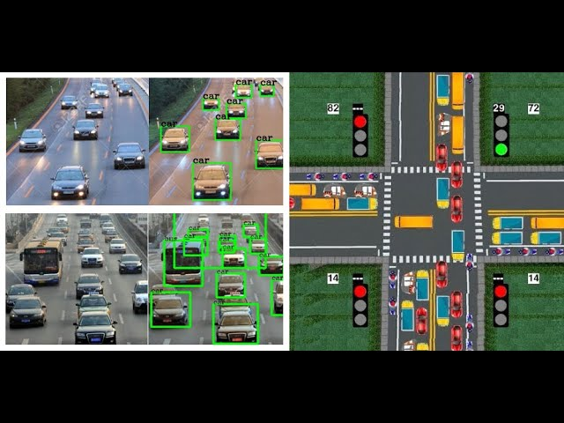
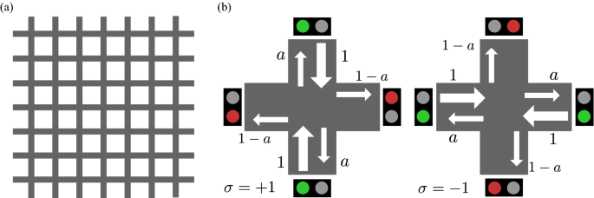
SIMULATION
Option 2: GUI (Tkinter/Pygame)
Colored circles (RED/GREEN)
Timer-based switching
Option 1: Console output
“Lane A → GREEN for 34s”

Slide 11
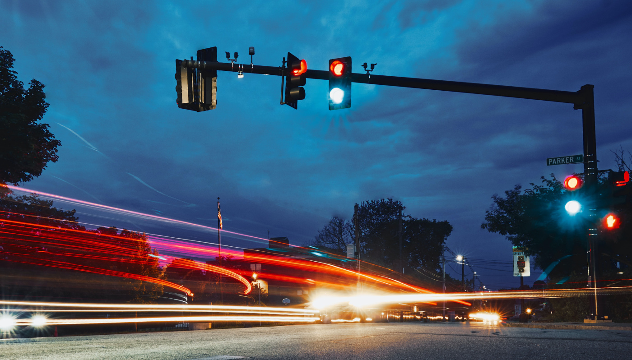
RESULT
Dynamic signals adjust in real-time
Reduced waiting time
Fully simulated cycle for demo
Efficient traffic flow

Slide 12
TEAM ROLE
Role | Task
Vision Lead | Input video + detection pipeline
Counting Logic | Lane-wise vehicle counting
Signal Control | Timing formula + decision logic
UI Developer | Simulation GUI (Tkinter/Pygame)
Integration & Docs | Connect modules + presentation
Signal Hardware Engineer | Relay control, microcontroller setup, circuit design

Slide 13
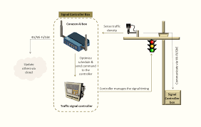
FUTURE SCOP
Real-time deployment with CCTV feeds
Integration with city traffic system
Emergency vehicle priority (ambulance/fire trucks)
Data logging for traffic analytic

Slide 14
THANK YOU

